Slide 1
METHODOLOGY OF DIGITAL HUMANITIES:
THE GOOD AND THE UGLY
Kiana Eunice Florendo, Daqin (Mike) Lin, and Anna Remler
Notes:
Anna: Good afternoon everyone! We hope you are having a wonderful day today wherever you are. We’re glad to have you all here with us today. For my group’s presentation and project, we are going to talk about the Methodology of Digital Humanities: The Good and the Ugly.

Slide 2
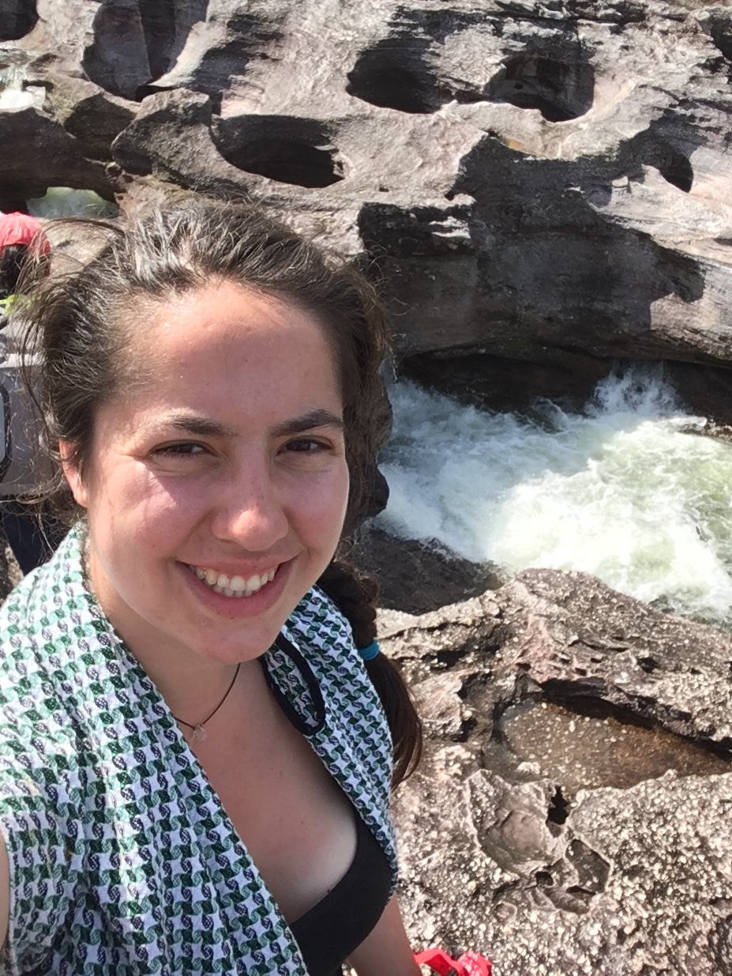

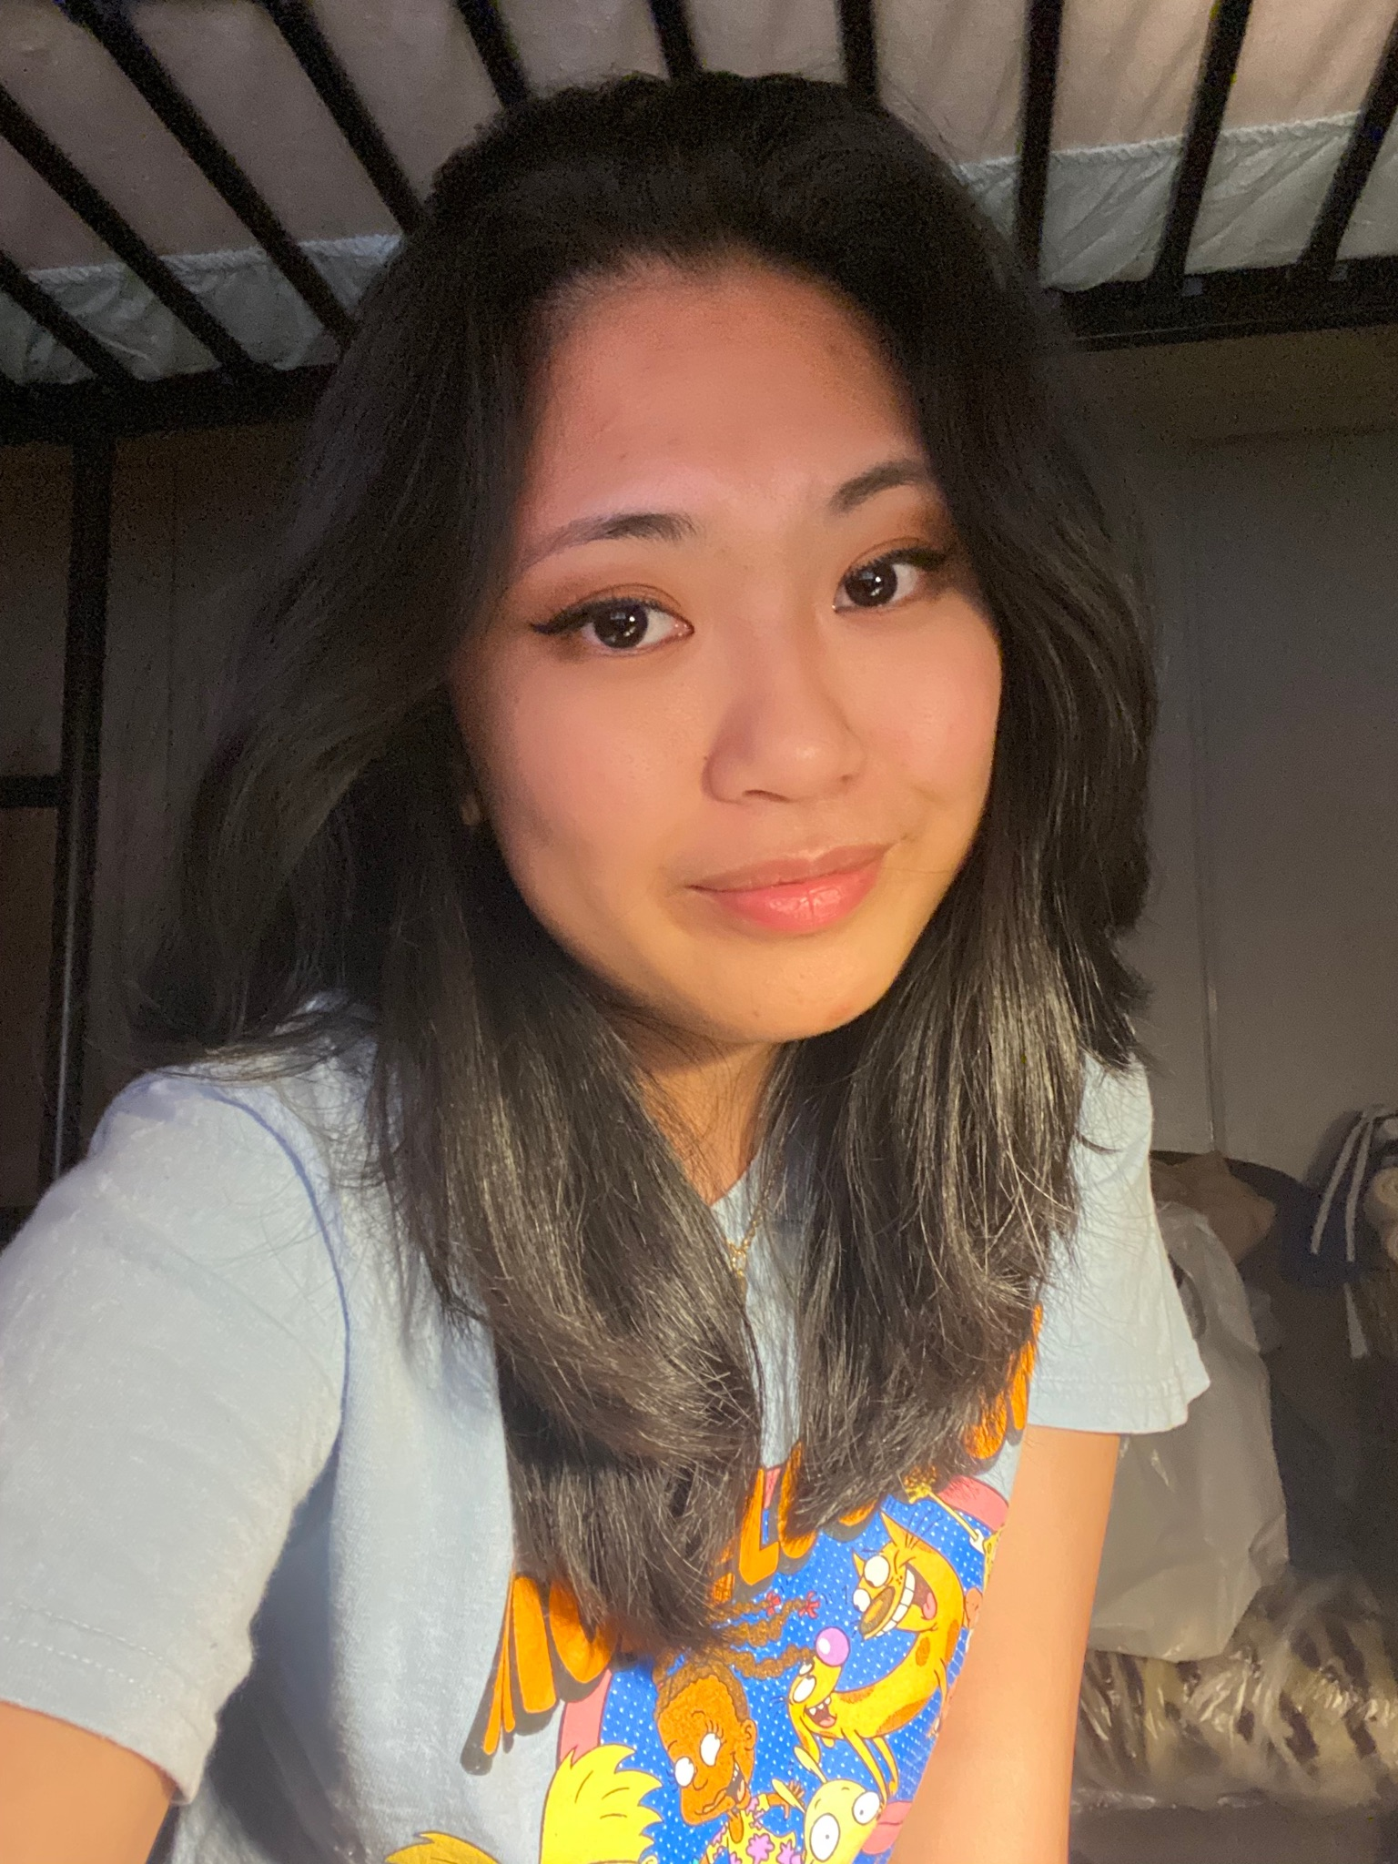
OUR TEAM
Anna Remler
Daqin (Mike) Lin
Kiana Florendo
History and Literature she/her/hers
Computer Science
he/him/his
Data Science she/her/hers
Notes:
All: Before we get started, let us introduce ourselves!
* Anna introduces herself
* Mike introduces himself
* Kiana introduces herself

Slide 3
TABLE OF CONTENTS
01
02
03
04
BACKGROUND & OBJECTIVES
EXPECTED RESULTS & METHODOLOGY
OUTCOME & CONCLUSION
REFERENCES
Notes:
Anna: For our presentation today, we are going to focus on 4 key areas. First, we’ll walk you through the objective of our proposal as well as any background information. Next, we’ll step into our methodology, or the way we have done our research, as well as explain what we expect once we are done with our research. Lastly, we will go over our findings and conclude our understandings, as well as review our references for this project.

Slide 4
1
BACKGROUND & OBJECTIVES
Let’s go over our goals for this project.
Notes:
Anna: Let’s go over our goals for this project.

Slide 5
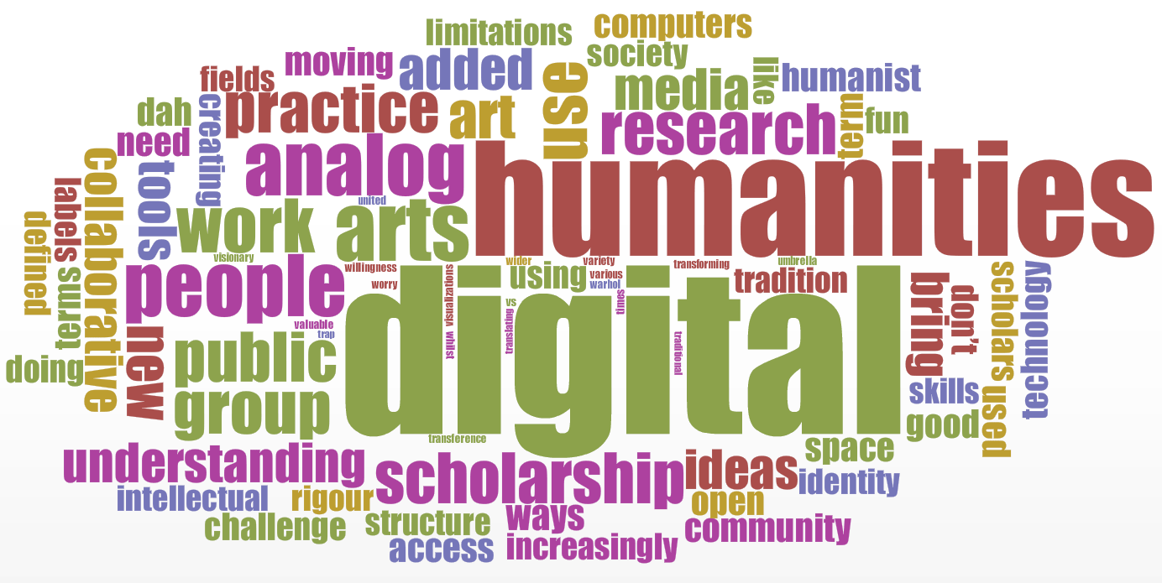
BACKGROUND
QUALITATIVE
QUANTITATIVE
Qualitative
Qualitative
VS.
Numerical Data
Facts
Descriptive data
Based on 5 sense
Notes:
Anna: The Digital Humanities provides an incredible amount of benefits and outlooks towards handling data. For instance, Digital Humanities provides an overlap with qualitative and quantitative data, collaboration between those in different fields of studies, and public impact. While appreciating the strengths within this field, we must also identify any weaknesses.

Slide 6
To observe the possible cons inside the methodology of Digital Humanities, specifically in the way we might interpret data and manipulate data and figure out ways we can improve our research as digital humanists.
OUR AIM
Notes:
Anna: With this said, the aim of this proposal is to observe the possible cons inside the methodology of Digital Humanities, specifically in the way we might interpret data and manipulate data and figure out ways we can improve our research as digital humanists.

Slide 7
KEY RESEARCH CHALLENGES
1.
2.
3.
Identify methodology of manipulating data.
Identify any downsides of the methodology.
Find improvements to acquire accurate results.
Notes:
Anna: Our key research challenges will be: identifying the methodology of manipulating data, identifying the downside of the methodology of manipulating data, and to find improvements to acquire accurate results.

Slide 8
2
EXPECTED RESULTS & METHODOLOGY
Let’s talk about our process and what we expect.
Notes:
Anna: Now, let’s talk about our process and what we expect.

Slide 9
METHODOLOGY/PROJECT STRATEGIES
CREATE GENERAL ASSUMPTIONS
1
ANALYZE TEXT (CLEMENT, OWENS, & GRIMMER)
There are many ways data can be manipulated.
There are always pros and cons towards anything.
Anything can be improved.
2
FORMULATE CONCLUSION AND FURTHER STEPS
3
Notes:
Anna: To start, we’ve developed some general assumptions. For instance, we assume that there are many ways data can be manipulated, that there is always good and bad towards anything, and that anything can be improved. Next, we will formally analyze the texts written by Clement, Owens, and Grimmer to learn more about the methodology of manipulating data. To conclude our research, we hope to identify benefits and disadvantages towards the methodology, and find ways to improve any results.

Slide 10
3.1
OUTCOME: THE GOOD
Oooh ah!
Notes:
Daqin: Now that we’ve talked about our goals and our process, let’s go over our findings, the good side.

Slide 11
OUTCOME: THE GOOD
“Defining Data for Humanists: Text, Artifact, Information, or Evidence”
by Trevor Owens
1.
2.
3.
DATA AS CONSTRUCTED ARTIFACTS
DATA AS INTERPRETABLE TEXTS
DATA AS PROCESSABLE INFORMATION
Notes:
Daqin: Carefully going through each article helped us prove and disprove many of our general assumptions. Owens helped us understand the different ways we can use data. He acknowledged that data can be treated as three different things: something that is constructed in order to be useful for a specific audience, something that can be interpreted differently, and something that can be manipulated in order to fit a perspective.

Slide 12
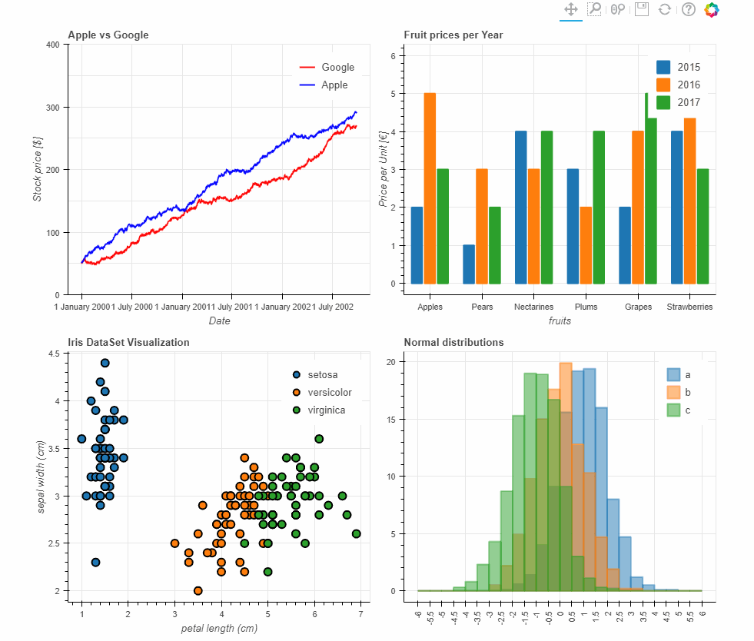
An opportunity to show a user’s skill and the endless perspectives/results from manipulated data can be seen as a plus.
OUTCOME: THE GOOD
Notes:
Daqin: Because of the flexibility of handling and using data, dealing with data should be used as an opportunity to show skills of the user rather than an ideal methodology. With this information, we could see that there are many possibilities and outcomes depending on who is using the data. An opportunity to show a user’s skills and the endless perspectives/results from manipulated data can also be seen as a plus.

Slide 13
3.2
OUTCOME: THE UGLY
Oh no!
Notes:
Daqin: Although, the idea of having endless possibilities and perspectives may contribute to the ugly side of this methodology. Next, we will explore the downside of this methodology, or the lack thereof.

Slide 14
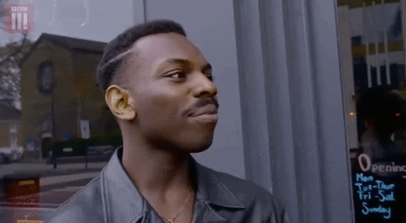
“Where is Methodology in Digital Humanities?”by Tanya E. Clement
OUTCOME: THE UGLY
“In the essay “Time, Labor, and ‘Alternate Careers’ in Digital Humanities Knowledge Work,” she tells her personal origin story as an ‘alternative academic’.”
Notes:
Daqin: Clement explained that the theory and validity of knowledge is completely linked towards how a certain users think and their personal experiences. As an example, she overlooks Julia Flanders’s essay “Time, Labor, and ‘Alternate Careers’ in Digital Humanities Knowledge Work”, where Flanders uses her personal experiences as a way to prove her point in her essay.

Slide 15
OUTCOME: THE UGLY
The manipulation of data could be construed in a way to just show accuracy and preciseness based on the user’s experiences and prior way of thinking, rather than an centralized idea.
Self study
Notes:
Daqin: Clement continues with that example to explain that self-study is not really a valid approach to work in the Digital Humanities. Connecting with what we know about manipulating data, data could be construed in a way to just show accuracy and preciseness based on the user’s experiences and prior way of thinking or to achieve certain research goals, rather than an centralized idea. So maybe instead of trying to make a summary of what the data is about, one would extract part of the information and try to come up with a conclusion that’s not consistent with what the majority of the data is about. And because people are different with the way we think, we cannot always rely on this kind of manipulated data to prove or disprove something. It is difficult to show a concrete idea, especially when dealing with qualitative datasets.

Slide 16
3.3
OUTCOME: CONCLUSION
What now?
Notes:
Kiana: Now that we have gone over the good and the ugly, what now? Could we do something to move towards the path of more accurate results?

Slide 17
METHODOLOGY/PROJECT STRATEGIES
CREATE GENERAL ASSUMPTIONS
1
ANALYZE TEXT (CLEMENT, OWENS, & GRIMMER)
There are many ways data can be manipulated.
There are always pros and cons towards anything.
Anything can be improved.
2
FORMULATE CONCLUSION AND FURTHER STEPS
3
Notes:
Kiana: As mentioned before, we started with this project with general assumptions. We learned the different ways data can be manipulated, that there is good and bad to anything, specifically like the methodology in digital humanities. Now, we want to know: what can we do to improve the methodology?

Slide 18
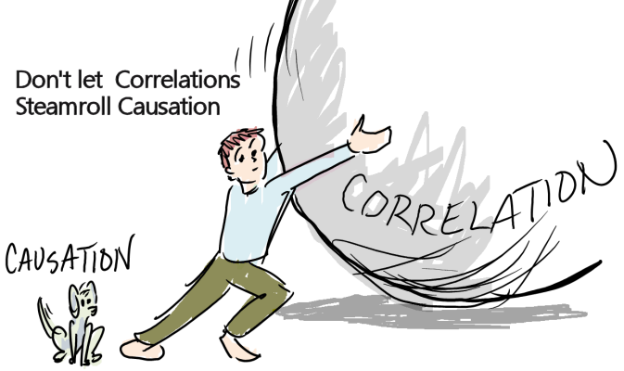
“We Are All Social Scientists Now: How Big Data, Machine Learning, and Causal Inference Work Together?”by Justin Grimmer
OUTCOME: CONCLUSION
“... ‘big data’ alone is insufficient for solving society’s most pressing problems—but it certainly can help.
Notes:
Kiana: As an attempt towards an improvement, we believe that different outlooks and perspectives are important when analyzing us. Grimmer acknowledged that manipulating and using big data alone is insufficient to make valid conclusions.

Slide 19
STEPS TOWARDS IMPROVEMENTS
1.
2.
3.
Including more data into specific research can improve causal inferences in large-scale datasets.
When the focus of study is targeted towards social theories, we should include more people.
Take advantage of machine-learning methods, or other computational methods when doing research.
Notes:
Kiana: With that said, we have uncovered three crucial things to improve research. First, we suggest including more data. Grimmer believes that we should borrow information from units that are far from our focus, in order to fully understand the focus of research.
Second, we should include more people in our research, especially when studying social theories. Grimmer believes that the massive scale of experiments provides the chance to move away from coarse treatments estimated at the population level to more granular treatments in more specific populations.
Third, we should take advantage of machine-learning methods, or other computational methods when doing research. Grimmer believes that the computational methods associated with the analysis of big data can help with designing experiments or making causal inferences. These methods could also help improve what we learn from the experiments done.

Slide 20
ENDING REMARKS
“For ‘big data’ to actually be revolutionary, we must recognize that we are all social scientists now--regardless of in which field our degree is.”
- Grimmer
Notes:
Kiana: Methodologies within the Digital Humanities may not be perfect, but we are slowly and surely moving towards the improvements for more accurate data. To quote Grimmer, “For ‘big data’ to actually be revolutionary, we must recognize that we are all social scientists now, regardless of in which field our degree is.” Improving our ways, especially in research, is a team effort, no matter what backgrounds or what field of study we’re in.

Slide 21
4
REFERENCES
Without them, we wouldn’t be here.
Notes:
Kiana: To end, we want to shortly preview our references for this project.

Slide 22
REFERENCES
Clement, Tanya. “14. Where Is Methodology in Digital Humanities? | Tanya E. Clement in Debates in the Digital Humanities.” Debates in the Digital Humanities 2016, 13 Apr. 2016, dhdebates.gc.cuny.edu/read/untitled/section/cfa5a92d-0d35-4e3d-b632-85644039cb1c
Flaticon. Icons for presentation template.
Freepik. Infographics and images for presentation template.
Grimmer, Justin. “We Are All Social Scientists Now: How Big Data, Machine Learning, and Causal Inference Work Together.” PS: Political Science & Politics, vol. 48, no. 01, 2014, pp. 80–83. Crossref, doi:10.1017/s1049096514001784.
“How to Write Your Research Proposal | University of Westminster, London.” University of Westminster, www.westminster.ac.uk/study/postgraduate/research-degrees/entry-requirements/how-to-write-your-research-proposal. Accessed 21 June 2021.
Owens, Trevor. “Defining Data for Humanists: Text, Artifact, Information or Evidence? Journal of Digital Humanities.” Journal of Digital Humanities, 15 Dec. 2011, journalofdigitalhumanities.org/1-1/defining-data-for-humanists-by-trevor-owens.
Slidesgo. Presentation Template: Kawaii Interface for Marketing.
Notes:
Kiana: For our project, again, we used the readings written by Owens, Clement, and Grimmer. Other miscellaneous references helped create our presentation today.

Slide 23
QUESTIONS, COMMENTS, CONCERNS?
Notes:
Kiana: With that, are there any questions?

Slide 24
THANK YOU!
Notes:
Kiana: Thank you so much! We hope you enjoyed our presentation today.

